Slide 1
Using the naturecounts R package to assess satellite-derived data products for model development.
Rory Macklin
Open Door Science
February 27th, 2026

Slide 2
Why do ornithologists care about satellites?
Notes:
At first glance, satellites and ornithology have very little to do with each other…
But, as satellite technology and imagery have developed, the data products derived from images from space have become more and more crucial to ecological study.

Slide 3
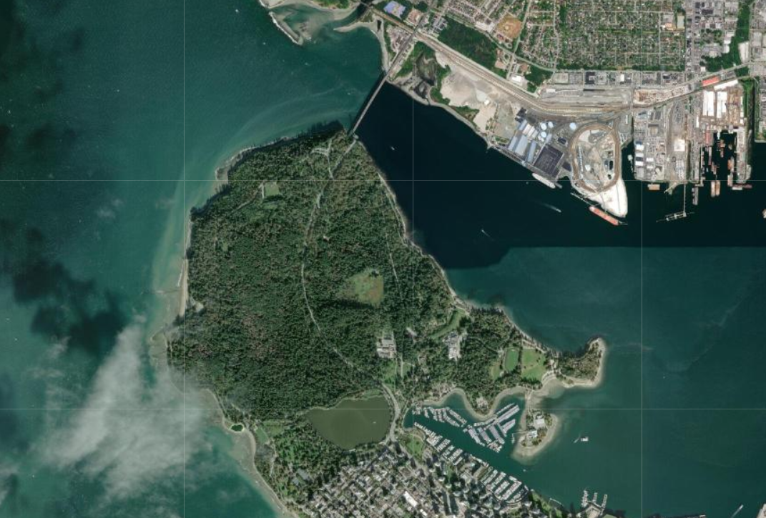
Notes:
Take, for instance, this one site from the British Columbia Marsh Monitoring Program at Beaver Lake in Stanley Park, here in Vancouver, BC.

Slide 4
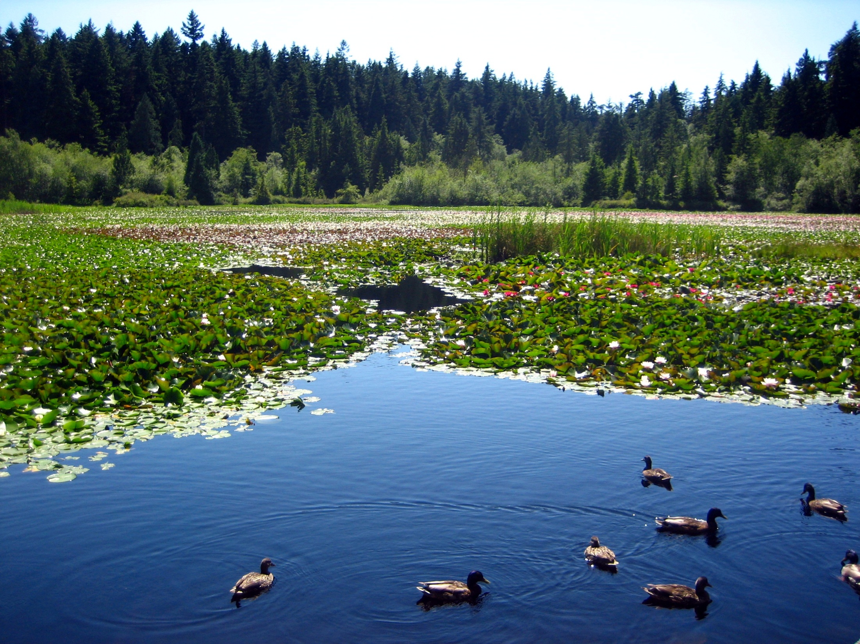
“Beaver Lake” by Christopher Porter, CC BY-NC-ND 2.0
Notes:
This is what we would see if we were to stand at the site. The Marsh Monitoring Program counter would be able to reliably count the birds that are present in a 100 m radius and with some extra work collect some data to summarize the habitat in that area.

Slide 5
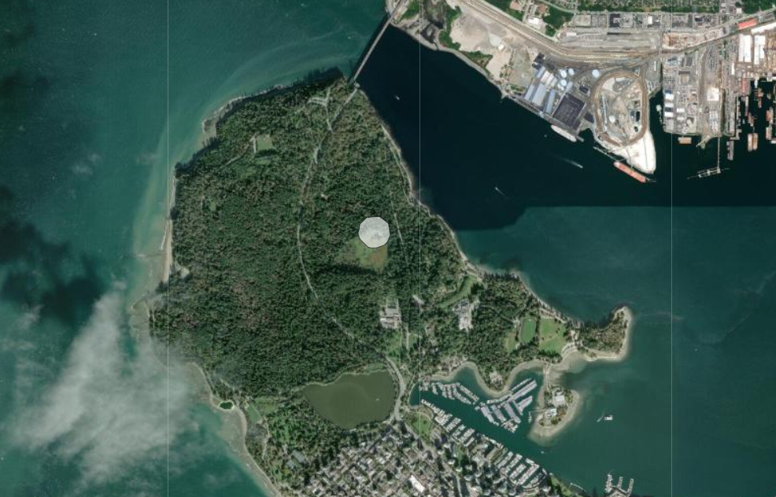
Notes:
For reference, this is what a 100m buffer around that site looks like. While conditions in this area may determine the fine-scale habitat selection decisions that birds make, it is quite likely that birds are also responding to habitat conditions at greater scales.

Slide 6
So, time to go and count all those trees?
Notes:
Obviously not, this would not be practical.
Also, what about the things that a counter can’t directly survey? That year’s rainfall compared to previous rainfall norms, etc.

Slide 7
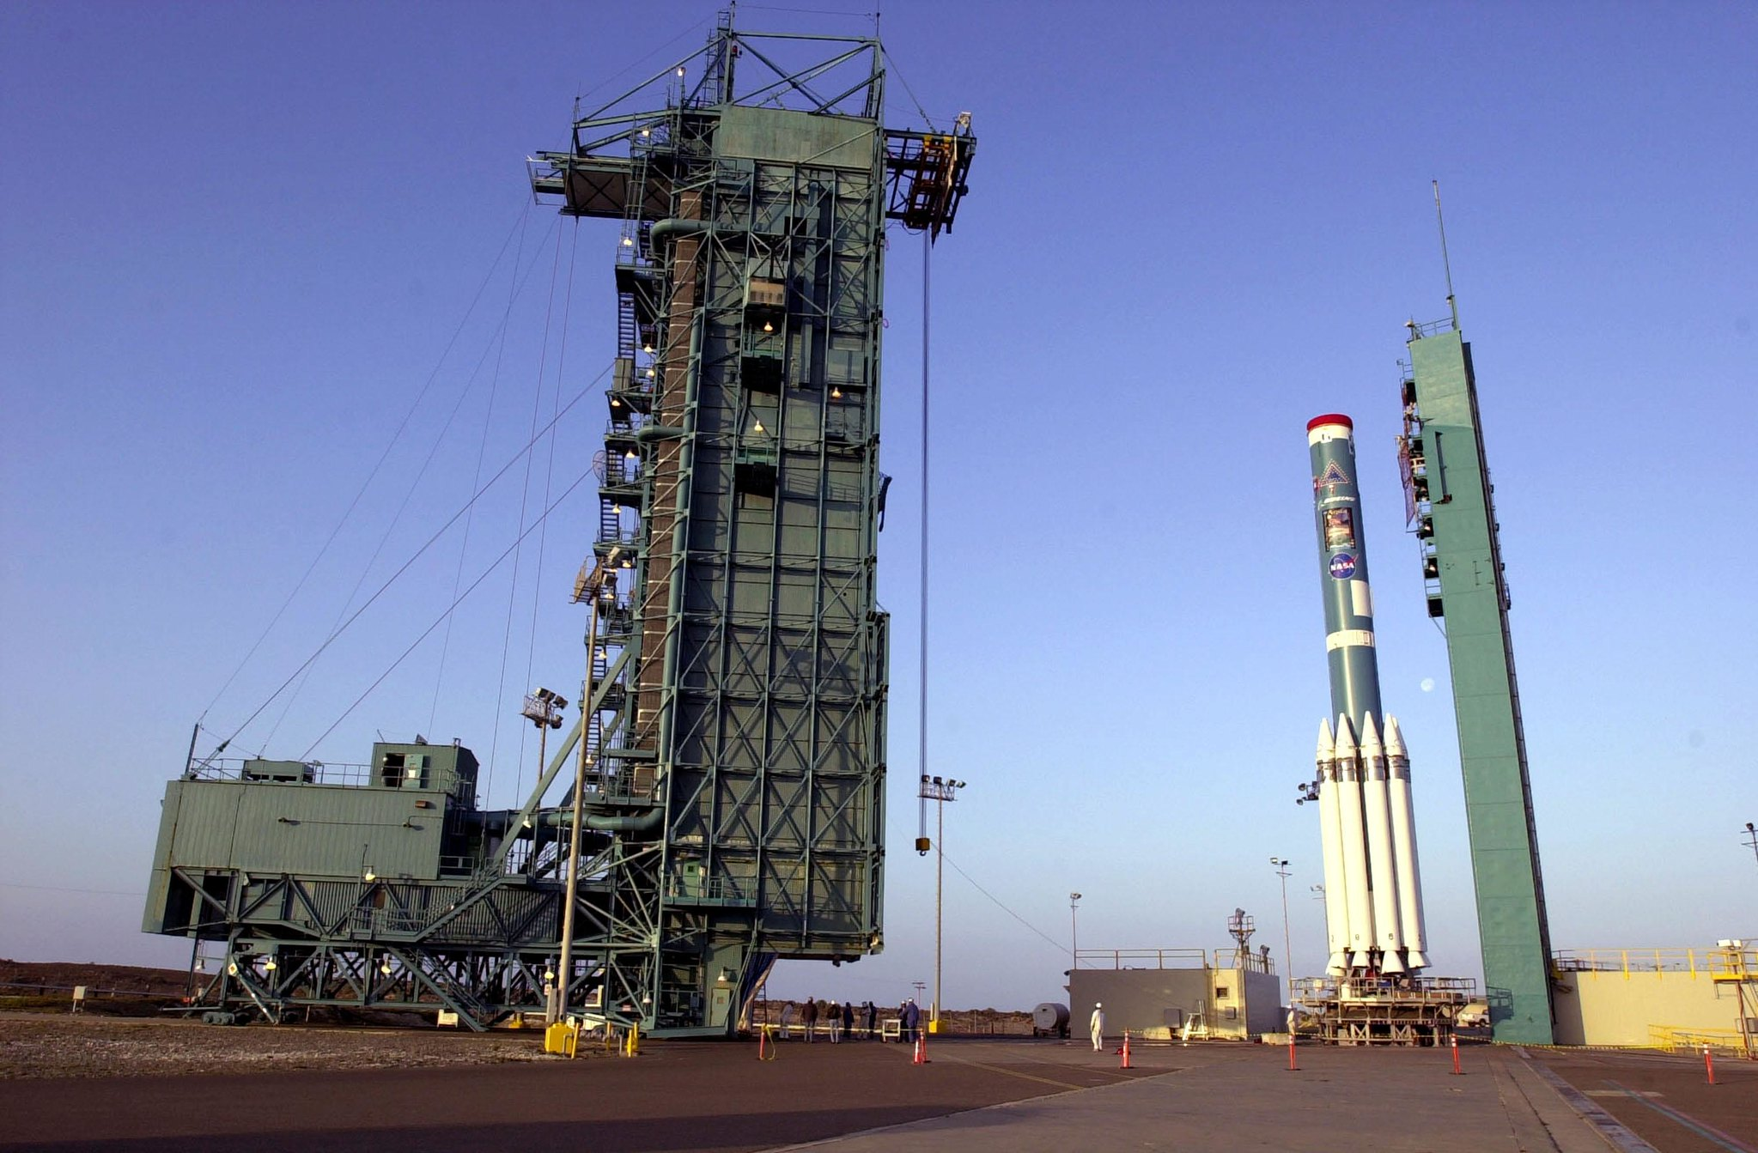
Eyes in (well, beyond…) the skies
Satellite imagery…
covers broad spatial extents
is updatable, covering broad temporal extents
can be processed to map derived measures of habitat (e.g. land cover type, tree density)
“Aqua on the Launch Pad” by NASA Goddard Space Flight Center, CC BY 2.0

Slide 8
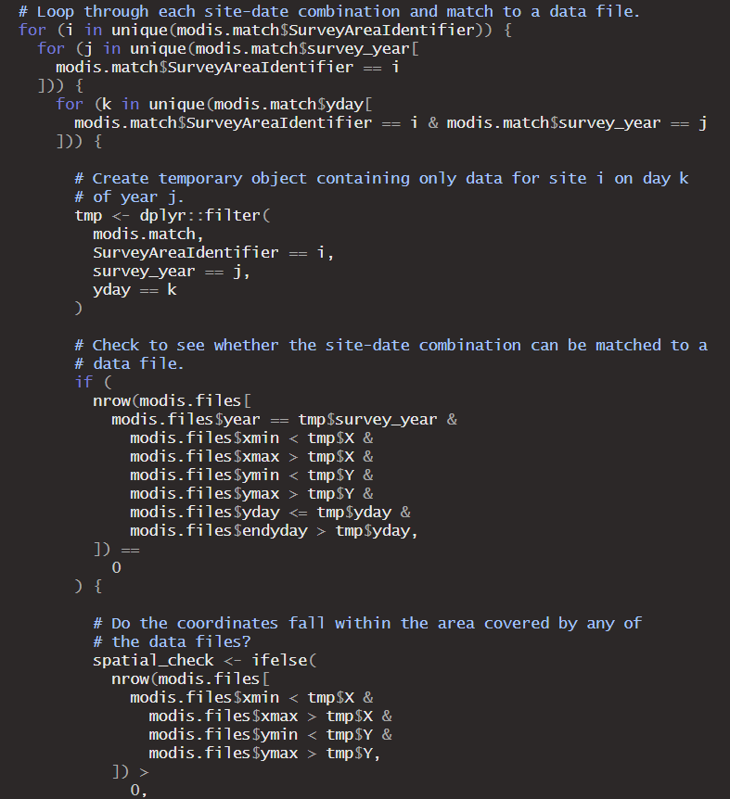
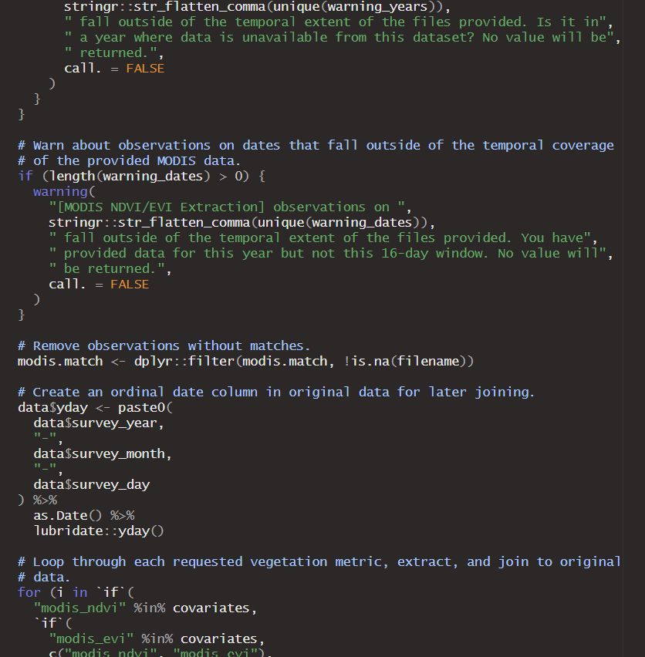
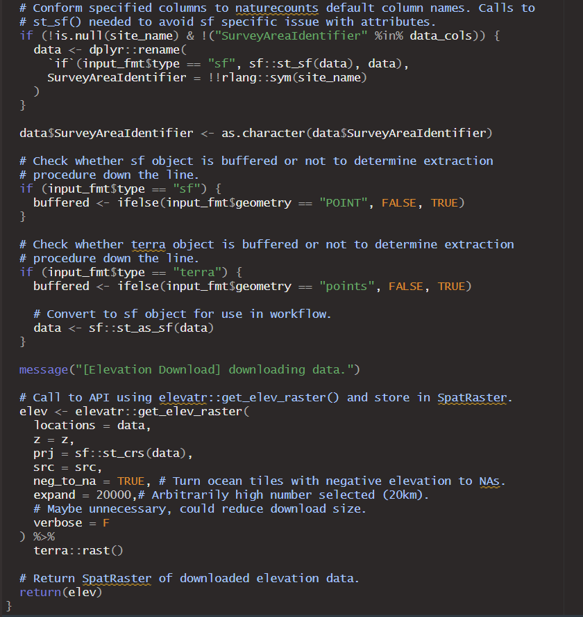
Notes:
So, how do we make these great sources of data more accessible?

Slide 9
Canadian Space Agency Grant
Naturecounts App
“Develop applications and interfaces to allow external market users to access the SEO integrated tools available in the NatureCounts mobile application.”
naturecounts R Package
“Enable streamlined integration of biodiversity data and SEO, and empower researchers to create innovative solutions to conservation challenges.”
SEO = Satellite Earth Observation (i.e., satellite-derived data)
Notes:
This was a guiding question behind a grant we recently received from the CSA. In this grant, we proposed to make satellite data easier to access for end-users of naturecounts products in two ways.

Slide 10
Could we extend the naturecounts R package so users could easily access satellite-derived data products to accompany their data?
Notes:
Currently, naturecounts R package primarily used to import data from NatureCounts database to R environment.

Slide 11
Data Type | Data Source | Spatial Resolution | Temporal Resolution
Land Cover Proportion | MODIS Land Cover | 500 m | Annual (2001-Present)
NDVI/EVI | MODIS Vegetation Indices | 500 m | 16-day (2000-Present)
Elevation | AWS Terrain Tiles | ~600-800m | Static
Historical Climate Averages (1970-2000) | WordClim | 1 km | Static
Forest Biomass, Closure, Height, Species Comp. | SCANFI | 30m | Static (2020)
Weather Conditions | DAYMET | 1 km | Daily (1980-Present)

Slide 12
nc_covariates(data, covariates, buffer, buffer_radius, buffer_units, site_name, coord_lon, coord_lat, date_year, date_month, date_day, date_lubridate, date_ordinal, crs, ..)
Data from NatureCounts or another source. Can be a dataframe, or an sf/terra spatial object.
SiteCode | survey_year | …
ABCD-1 | 2021
ABCD-1 | 2022
ABCD-2 | 2022
ABCD-3 | 2022
ABCD-3 | 2023

Slide 13
nc_covariates(data, covariates, buffer, buffer_radius, buffer_units, site_name, coord_lon, coord_lat, date_year, date_month, date_day, date_lubridate, date_ordinal, crs, …)
List of desired covariates. Multiple sources can be listed.
e.g. c(“elevation”, “modis_lctype1”)

Slide 14
nc_covariates(data, covariates, buffer, buffer_radius, buffer_units, site_name, coord_lon, coord_lat, date_year, date_month, date_day, date_lubridate, date_ordinal, crs, …)
Should sites be buffered? By what radius?

Slide 15
nc_covariates(data, covariates, buffer, buffer_radius, buffer_units, site_name, coord_lon, coord_lat, date_year, date_month, date_day, date_lubridate, date_ordinal, crs, …)
If column names differ from BMDE format, specify them here.

Slide 16
nc_covariates(data, covariates, buffer, buffer_radius, buffer_units, site_name, coord_lon, coord_lat, date_year, date_month, date_day, date_lubridate, date_ordinal, crs, …)
If your date data is in lubridate or ordinal format, provide column names here.

Slide 17
nc_covariates(data, covariates, buffer, buffer_radius, buffer_units, site_name, coord_lon, coord_lat, date_year, date_month, date_day, date_lubridate, date_ordinal, crs, …)
Coordinate reference system of your data (if different from standard lat/long, EPSG:4326).

Slide 18
nc_covariates(data, covariates, buffer, buffer_radius, buffer_units, site_name, coord_lon, coord_lat, date_year, date_month, date_day, date_lubridate, date_ordinal, crs, ..)
Result: your original data returned with the new columns appended according to site and date.
SiteCode | survey_year | … | elevation | lctype1_urban
ABCD-1 | 2021 |  | 199 | 0.1
ABCD-1 | 2022 |  | 199 | 0.15
ABCD-2 | 2022 |  | 206 | 0.35
ABCD-3 | 2022 |  | 53 | 0.40
ABCD-3 | 2023 |  | 53 | 0.5

Slide 19
Feedback?
Any data sources you’d like to see included?
How will this tool be helpful for your programs?
Any options or tools you would like to see developed similar in scope?

